Slide 1


Slide 2
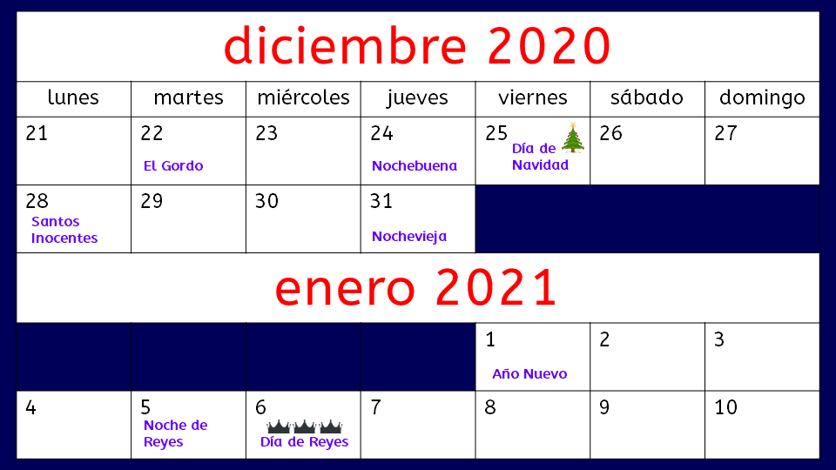

Slide 3


Slide 4
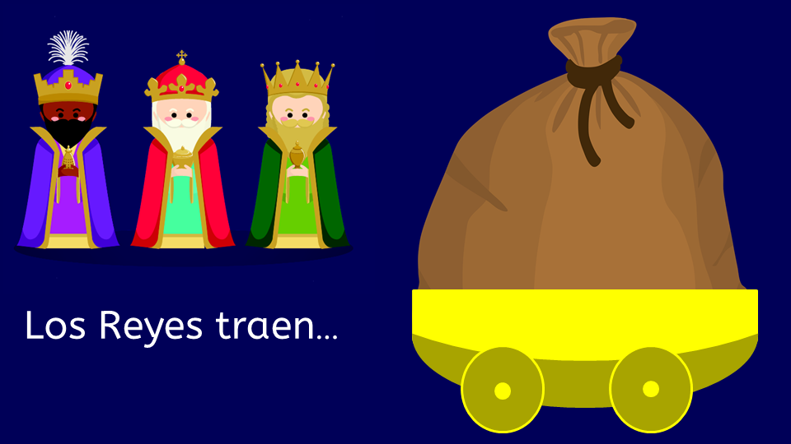

Slide 5


Slide 7
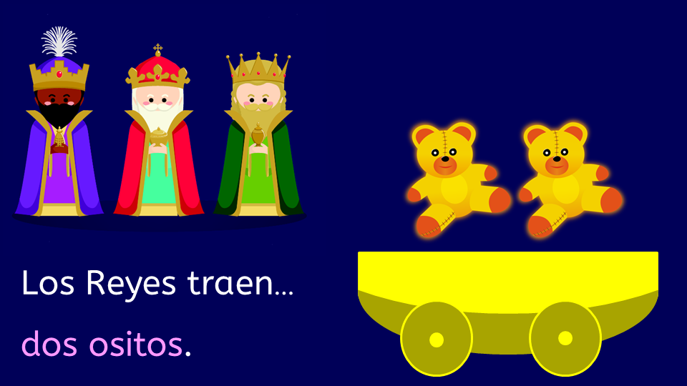

Slide 9
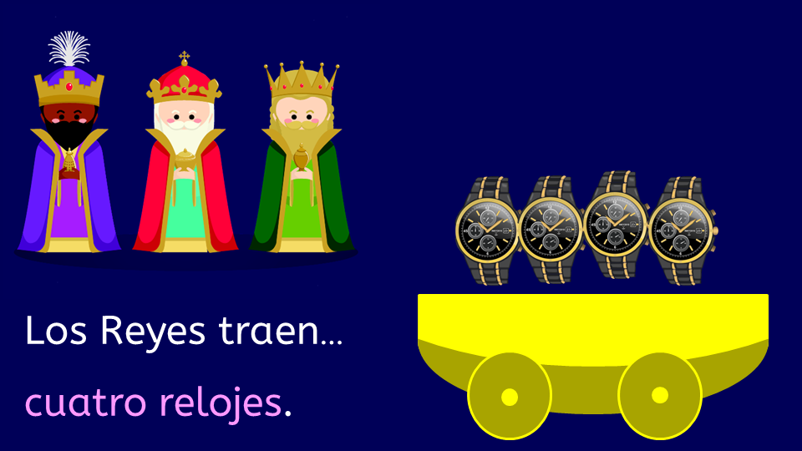

Slide 11
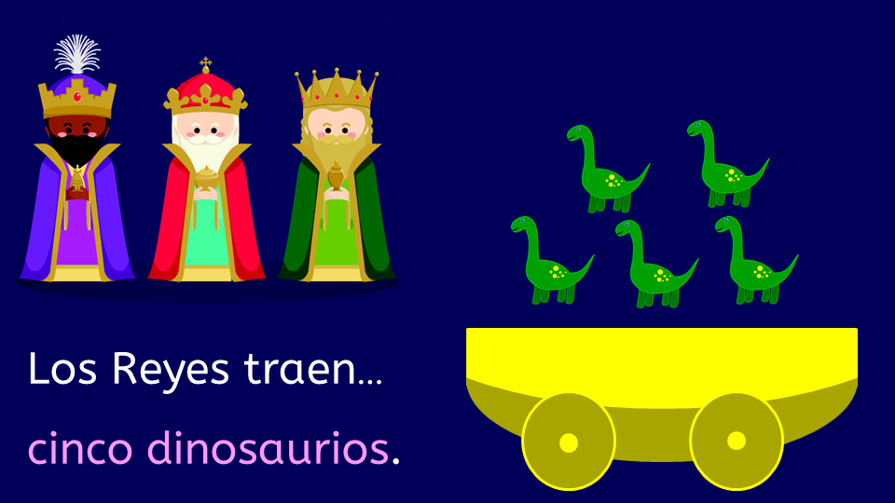

Slide 13
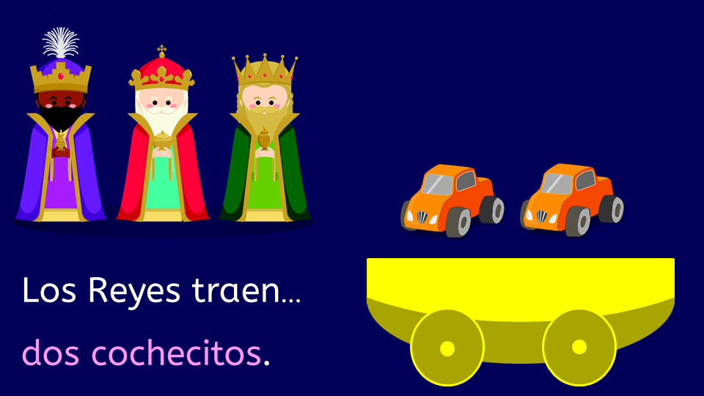

Slide 15


Slide 17
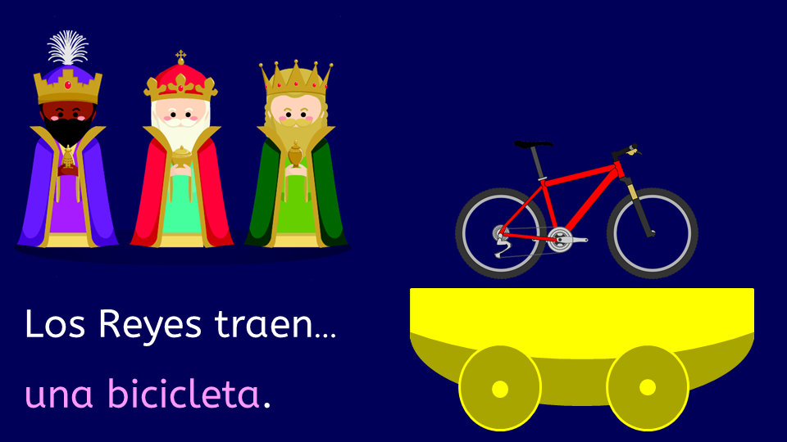

Slide 19


Slide 21
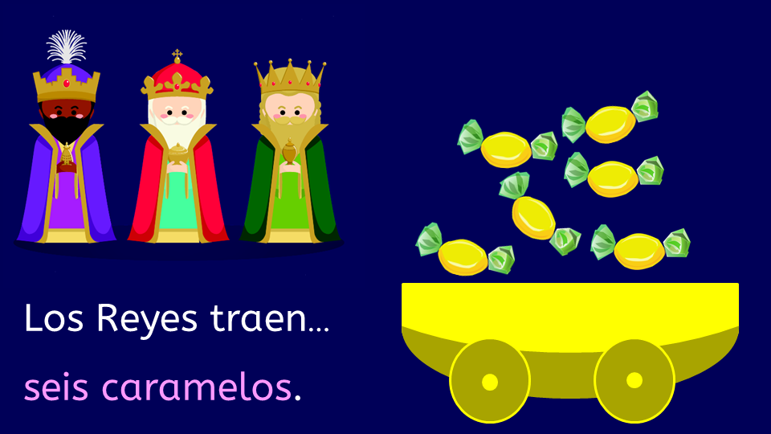

Slide 23
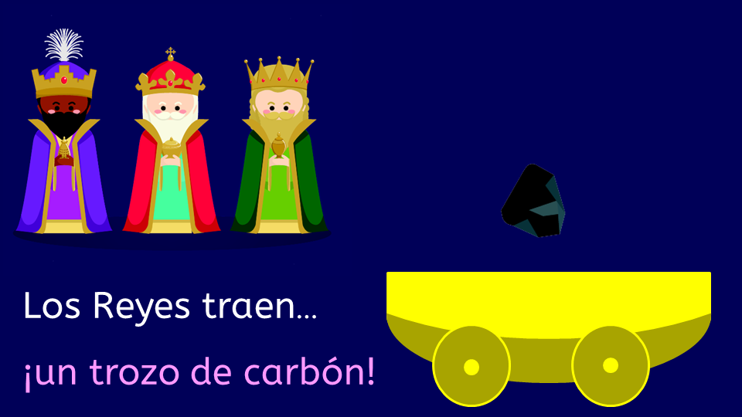

Slide 24
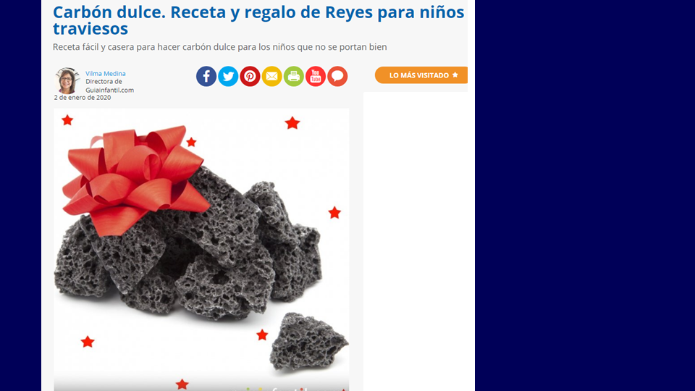
https://www.guiainfantil.com/recetas/recetas-de-navidad/carbon-dulce-regalo-de-reyes-para-ninos-traviesos/

Slide 25
