Slide 1
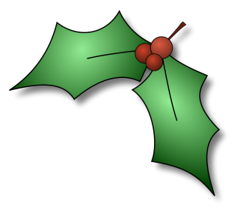
Gans
Stechpalme
Mistel
Schäfer
Esel
Lebkuchen
Lied
Kerzen
Stollen
Adventskranz
Engel
Geschenk
Efeu
König
Sekt
Tannenbaum
© Light Bulb Languages/HWhiteley 2019 http://www.lightbulblanguages.co.uk

Slide 2
Gans
Lebkuchen
Stollen
Sekt
Mistel
Stechpalme
Efeu
Tannenbaum
Schäfer
Esel
Engel
König
Lied
Kerzen
Adventskranz
Geschenk
© Light Bulb Languages/HWhiteley 2019 http://www.lightbulblanguages.co.uk

Slide 3
Gans
Lebkuchen
Stollen
Sekt
typical German Christmas foods and drinks
© Light Bulb Languages/HWhiteley 2019 http://www.lightbulblanguages.co.uk

Slide 4
Mistel
Stechpalme
Efeu
Tannenbaum
plants used to decorate the house at Christmas time
© Light Bulb Languages/HWhiteley 2019 http://www.lightbulblanguages.co.uk

Slide 5
Schäfer
Esel
Engel
König
characters in the Nativity story
© Light Bulb Languages/HWhiteley 2019 http://www.lightbulblanguages.co.uk

Slide 6
Lied
Kerzen
Adventskranz
Geschenk
objects associated with celebrating Christmas
© Light Bulb Languages/HWhiteley 2019 http://www.lightbulblanguages.co.uk

Slide 7
How to play The Wall:
Playing the game (you’ll already know how if you watch Only Connect!):
Students can work individually, in pairs or in small groups.
Show students slide 1, and give them a time limit within which they need to sort the words or phrases into 4 groups. Each group of words or phrases needs to have a link, and students will need to explain what the words or phrases in each group have in common.
At the end of the time, show the answers (slide 2). Students can check their own answers.
Show slides 3-6 in turn. Students will need to tell you what the link is between the 4 words or phrases shown. When you click, the answer in the white box will be revealed.
If you use this template to make your own game of The Wall and you’d like to share it, we would be really grateful if you could acknowledge this free template by sharing your game through Light Bulb Languages, as per item 6 of our copyright statement https://www.lightbulblanguages.co.uk/about.htm#cs Danke!
© Light Bulb Languages/HWhiteley 2019 http://www.lightbulblanguages.co.uk

