Slide 1
A | B | C | D
E | F | G | H
I | J | K | L

Slide 2
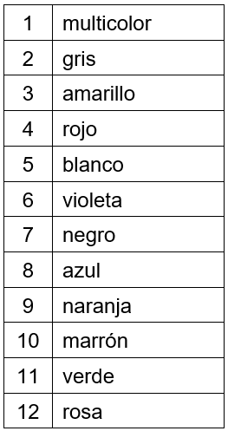
NOTES FOR THE TEACHER: TRANSCRIPT AND ANSWERS
1 | L
2 | K
3 | C
4 | A
5 | F
6 | H
7 | E
8 | B
9 | I
10 | J
11 | D
12 | G

