Slide 1
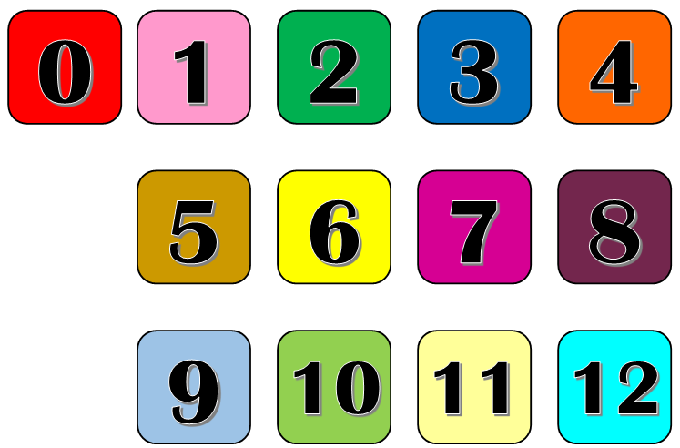
© Light Bulb Languages 2015 CS http://www.lightbulblanguages.co.uk

